Slide 1
Stroke – Pathophysiology Case Study
Alvin Carl de Guzman, BSN

Slide 2
Case Study
The patient, R.A. is an obese 65-year-old African American male who presented to the Emergency Department with a chief complaint of dizziness and left-sided weakness. The patient describes that his left upper extremity and left lower extremity feel numb and have a tingling sensation. He also cannot move both his left upper and lower extremities R.A. has a medical history of hypertension, dyslipidemia, hypercholesteremia, atrial fibrillation, and a BMI of 35. The patient stated he stopped taking Xarelto a month ago. The patient stated, “My heart felt better so I stopped taking the medication.” MRI with contrast shows a blood clot from the right main carotid artery in the brain.

Slide 3
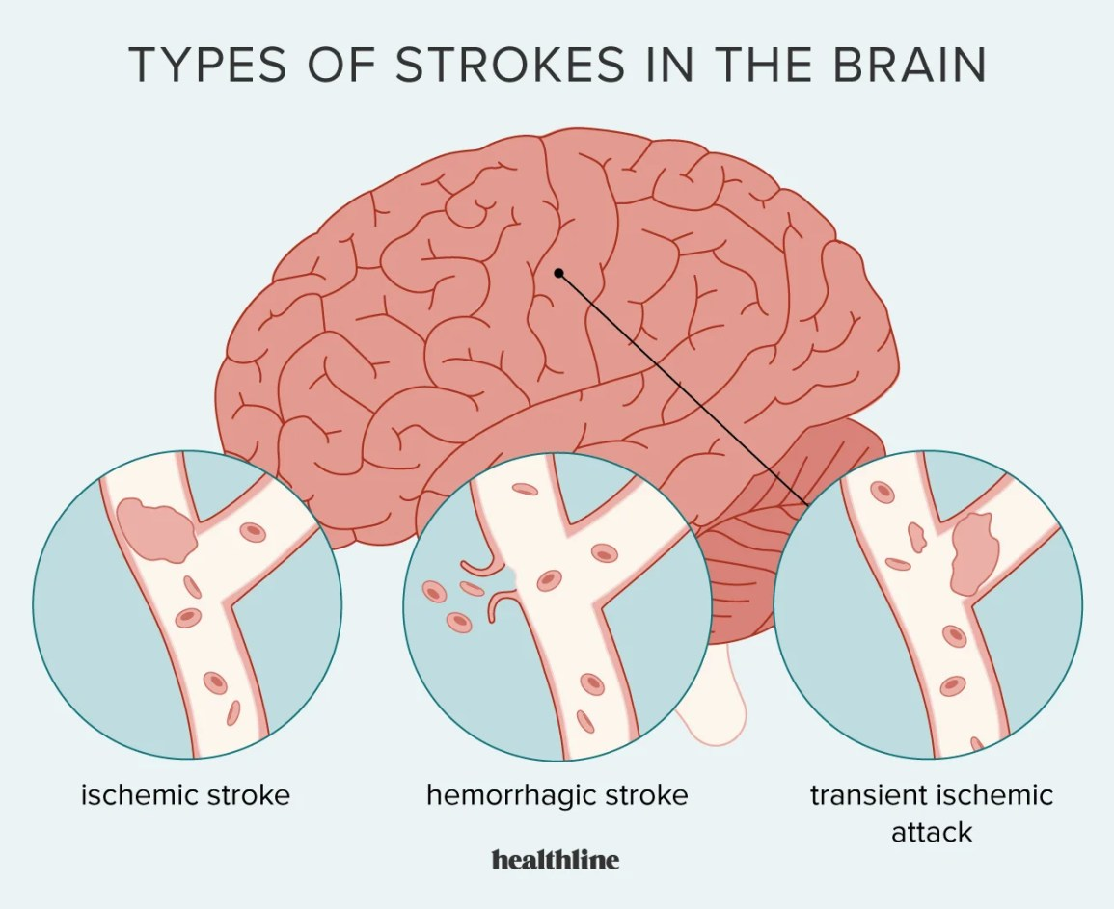
What kind of stroke could the patient be experiencing?
Ischemic Stroke or Hemorrhagic Stroke?
Hint: What did the MRI show?

Slide 4
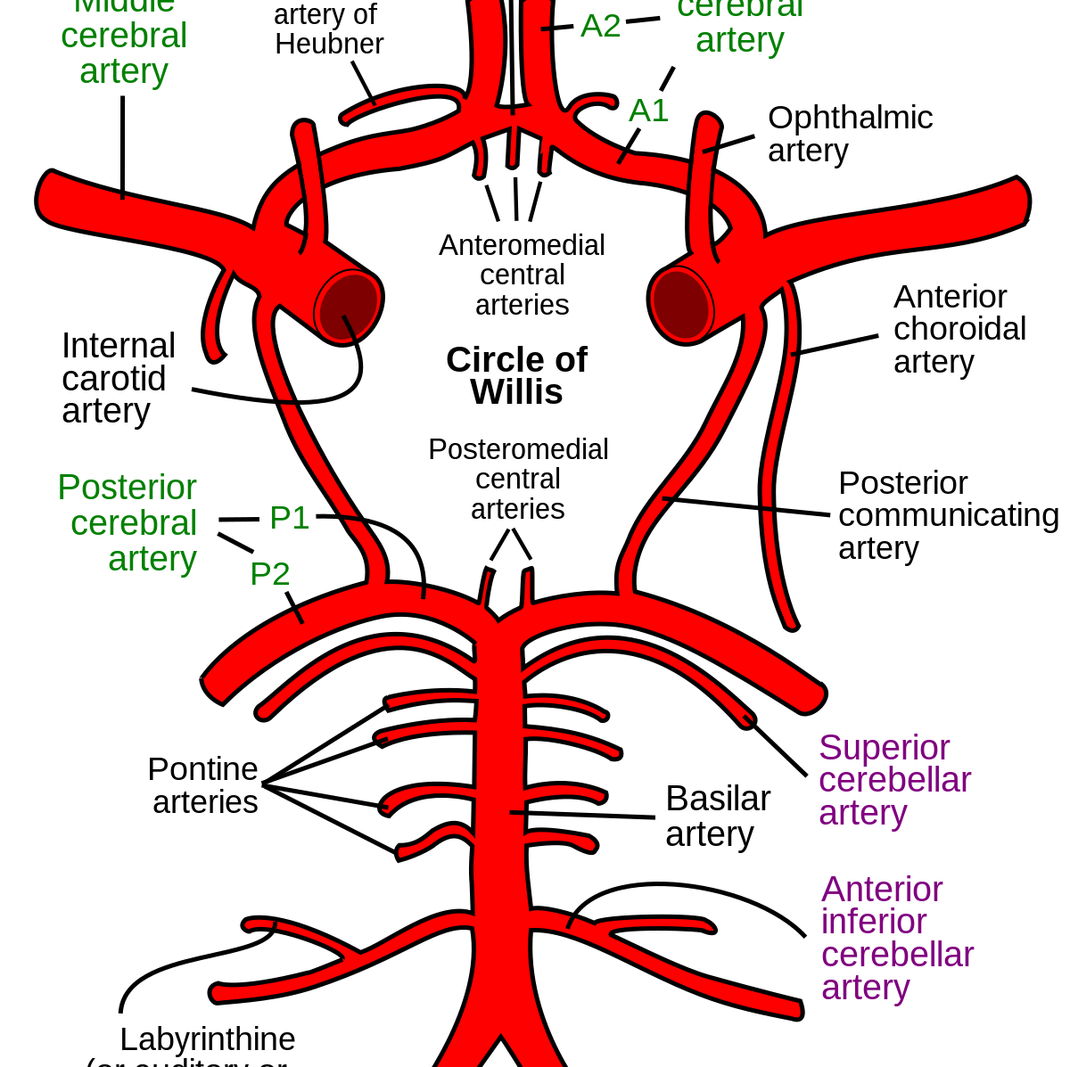
Pathophysiology and Etiology – Ischemic Stroke
A stroke is damage to the brain from the interruption of its blood supply. In this case, the signs and symptoms are caused by an ischemic stroke. An ischemic stroke could either be caused by a thrombotic stroke or an embolic stroke. The difference between a thrombotic versus an embolic stroke is a thrombotic stroke happens when a blood clot forms in an artery that leads to the brain. An embolic stroke is when a clot that formed elsewhere in the body breaks loose and travels to the brain.

Slide 5
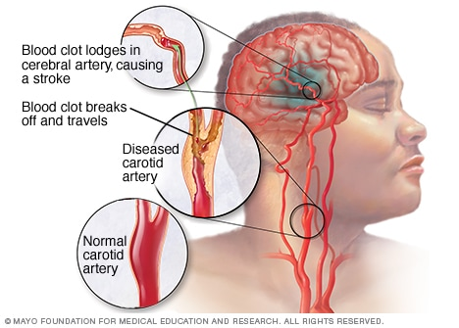
According to the patient’s history, what possibly could have caused a blood clot?
Hint:

Slide 6
Atherosclerosis
A blood clot often forms in arteries that have been damaged by the buildup of plaque, also known as atherosclerosis.

Slide 7
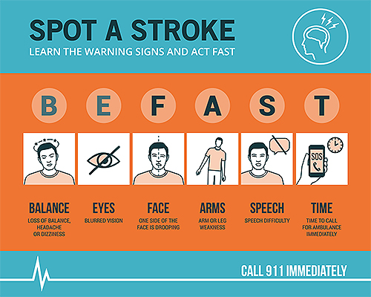
Signs & Symptoms
Left-sided deficits.
Left upper and lower extremity numbness and tingling.
Inability to move left upper and lower extremities.
Dizziness

Slide 8
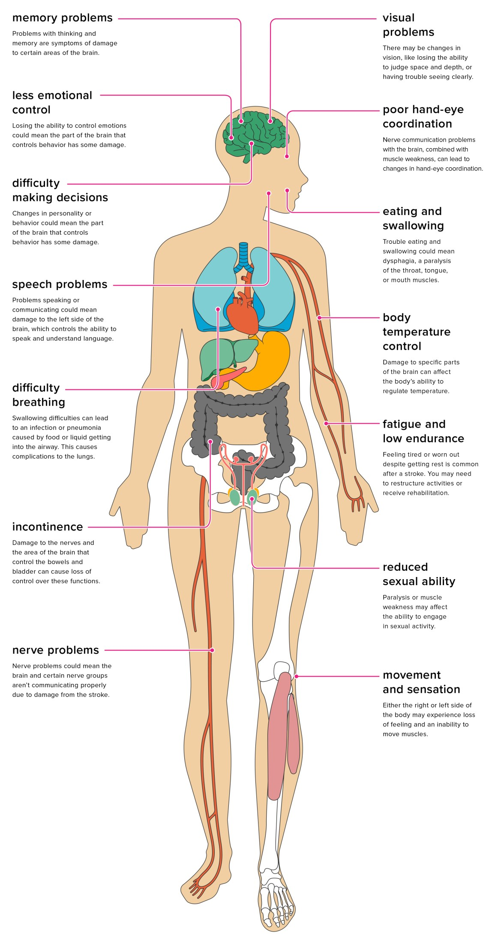
Health Problems
Hypertension
Dyslipidemia
Hypercholesteremia
Atrial Fibrillation
Obesity (BMI >30)
Interruption of halting blood thinners (Xarelto).

Slide 9
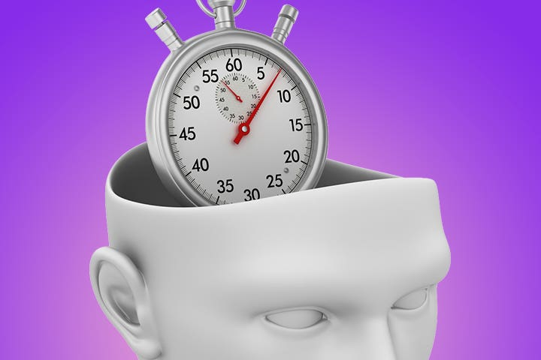
What treatment would the nurse expect to be administered within the first hours after identifying stroke symptoms?

Slide 10
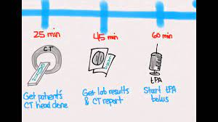
Interventions and Evaluation
“In the case of ischemic stroke, the most effective treatment for saving brain tissue is recanalization of the plugged vessel using thrombolytic therapy” (Szelenberg et al., 2020).
Initial Treatment
TPA (IV injections of recombinant tissue plasminogen activator)
  Given within the first three hours after stroke symptoms occur
  Restore blood flow by dissolving the blood clot causing the stroke

Slide 11
Interventions and Evaluation
Post-Stroke Treatment
After a stroke, spontaneous recovery is not usually a complete recovery. Rehabilitation is one of the most important steps in the care of a stroke patient.
“The following common movement-focused poststroke interventions have moderate evidence of effectiveness: cardiorespiratory training, therapeutic exercise, task-oriented training (task-specific training), CIMT, mental practice, and mirror therapy” (Lin & Dionne 2018).
Modern Rehabilitation
Cardiorespiratory training and aerobic exercises
Physical Therapy

Slide 12
Nursing Implications & Interventions
Blood Pressure Management
“BP variability in the first 24 hours is independently associated with increasing neurologic deterioration and an increase in intracranial pressure (ICP) that can lead to secondary brain injury” (Thomas & Amatangelo 2019).
Cardiac Monitoring
“Cardiac arrhythmias and abnormal electrocardiograms (EKGs) are identified in 50% to 70% of all acute stroke patients” (Thomas & Amatangelo 2019).
Airway and Respiratory Assessment
“Approximately half of all stroke patients with dysphagia will have an indication of aspiration and dysarthria. It is important to note that aspiration, like dysarthria, is a consequence of dysphagia and contributes to a 3-fold increase in mortality and length of stay, and a 6- to 7-fold increased risk of aspiration pneumonia” (Thomas & Amatangelo 2019).

Slide 13
Case Study (cont.)
After administration of TPA the patient regained mobility of his left upper and lower extremities but has a limited range of motion. The numbness and tingling recovered after a 24-hour observation. Continuation of his hypertension and cholesterol medications as well as continuing his blood thinner (Xarelto) medication was educated upon discharge.

Slide 14
Plan of Care
Following up with Physical Therapy
Continuation of medications
Education on the importance of medications

Slide 15
Question #1
A patient has been admitted to a stroke unit for having symptoms of dysphagia and right-sided weakness. What is the priority in the care of this patient?
Cardiac monitoring
Airway and Respiratory Assessment
Blood pressure monitoring
Temperature

Slide 16
Answer
B

Slide 17
Question #2
A nurse is teaching the types of strokes to a class of nursing students. Which of the following statements is true about the difference between an ischemic stroke and a hemorrhagic stroke?
a. An ischemic stroke is when blood is leaking in the brain and a hemorrhagic stroke is caused by a blood clot in the artery that leads to the brain.
b. An ischemic stroke is when blood leaks around the brain tissue and a hemorrhagic stroke is when a clot is formed elsewhere in the body that breaks loose and travels to the brain.
c. An ischemic stroke happens when a blood clot forms in an artery or is formed elsewhere in the body that breaks loose and travels to the brain and a hemorrhagic stroke is a blood leak inside the brain or around the brain tissue.
d. An ischemic stroke last only a couple of hours and a Hemorrhagic stroke lasts forever.

Slide 18
Answer
c

Slide 19
References
Lin, S. H., & Dionne, T. P. (2018). Interventions to Improve Movement and Functional Outcomes in Adult Stroke
Rehabilitation: Review and Evidence Summary. Journal of participatory medicine, 10(1), e3. https://doi.org/10.2196/jopm.8929
Szelenberger, R., Kostka, J., Saluk-Bijak, J., & Miller, E. (2020). Pharmacological Interventions and Rehabilitation
Approach for Enhancing Brain Self-repair and Stroke Recovery. Current neuropharmacology, 18(1), 51–64. https://doi.org/10.2174/1570159X17666190726104139
Thomas, S. B., & Amatangelo, M. P. (2019). Priority Nursing Interventions Caring for the Stroke Patient. Critical
Care Nursing Clinics of North America. doi:10.1016/j.cnc.2019.11.005

