Slide 1

SERVICE TEACHING ALLIANCE VOCATIONAL COLLEGE
Who we are:
Sandy/Tony/Alvin
What was our focus and why:
Requested by Nursing to develop a CNA Program
Utilized California guidelines to meet state requirements

Slide 2
Program Outcomes
Operates within the scope of practice of a CNA
Consistently uses common medical terms
Provides consistent and effective ADL’s
Applies effective therapeutic communication skills
Demonstrates professionalism & interprofessional collaboration
Correctly employs evidence-based treatment/procedures
Eligibility for the CA state certification exam

Slide 3
Prerequisites/ Admission & Progression Criteria
Prerequisite classes
Math 101
English 100
Intro to Anatomy & Physiology
Intro to Nursing
Admission criteria
High school diploma or GED
SAT 400 or higher
ACT 17 or higher
LiveScan
Physical exam, TB, Immunizations or titer
Progression criteria
No limit on attempts to pass hands-on modules #5-#13
Encouraged to practice outside of class during open lab times

Slide 4

Classroom & Lab Hours / College Credits
CNA101 – CNA117 (20 weeks) + Exam (1 week)
Classroom: 60 actual hours = 5.5 credits
Labs 100 actual hours = 3.0 credits
Didactic (3 hour session)-60 hours total. Modules #105, #108, & #112 will be two weeks of class and labs due to weigh of information. (Mon 9:00 AM – 12:00 PM).
Lab / VSim / Flipped Classroom (5 hour session) – 55 hours total starting on module #5 through module #17. (Mon 1:00 pm to 6:00 pm).
Off-site Clinical (9 hours per session for 5 weeks)- 45 hours modules #13-#17. (Wed or Thurs 6:00 am to 4:00 pm). Locations to be determined.

Slide 5
Teaching Staff
Sandy Sargent BSN, RN, PHN, CHC
(Office hours: Wed 5 pm – 7 pm)
Chaivut Tony Chungcharoenpanich BSN, RN
(Office hours: Wed 2 pm - 4 pm)
Alvin Carl de Guzman BSN, RN
(Office hours: Mon/Wed 3 pm – 5 pm)

Slide 6
Method & Materials of Instruction
In-person didactic and lab class (Lab, VSim, Flipped Classroom Simulation)
Docucare EHR/ EMR Software
Out-of-class assignments (Mosby) and exams
In-class review of homework on CNA questions, presentation of theory (lectures, discussion, quizzes)
Supervised off-site clinical experience (TBA)
On-campus lab experience
Textbook: Mosby's Essentials for Nursing Assistant 9th edition. Authors: Leighann Remmert MS, RN and Sheila Sorrentino PhD, RN
CNA: Nursing Assistant Certification, California Edition. Author: Dr. Carrie L. Jarosinski RN, CNE, CWP Eisbn13: 9781941626504
CNA Study Guide 2024-2025 / CNA Exam Prep

Slide 7
Evaluation of Learning
Exam and Essay Questions – 30%
In-Class participation – 10%
Class attendance – 20%
SIM/Skills – 30%
Weekly assignments – 10%

Slide 8
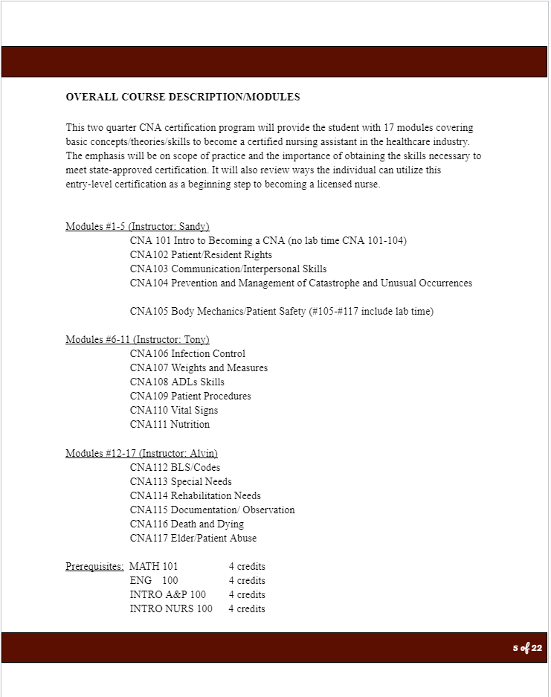
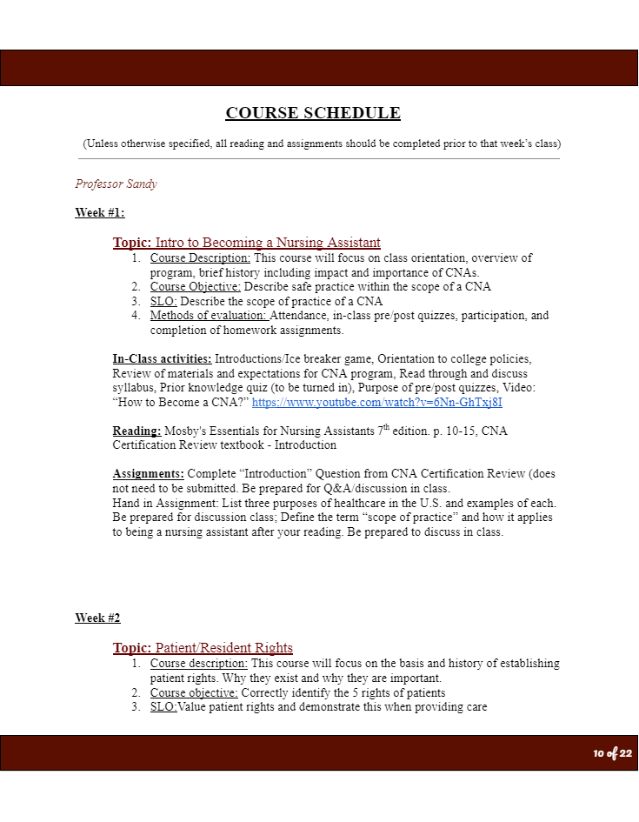
Course Schedule Summary

Slide 9
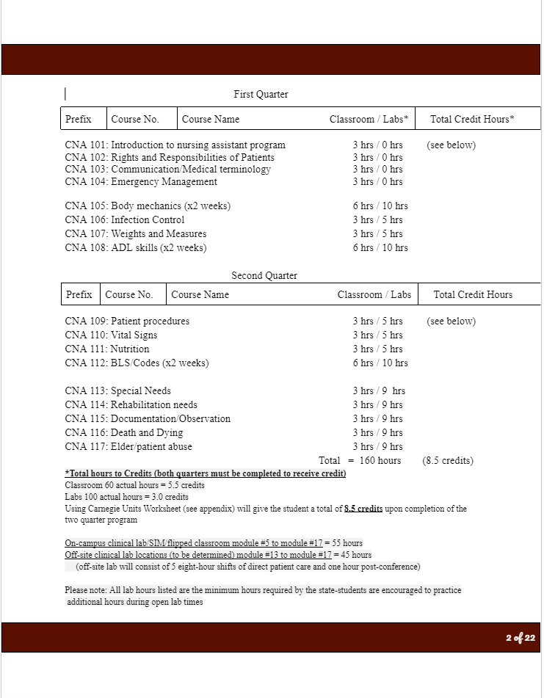
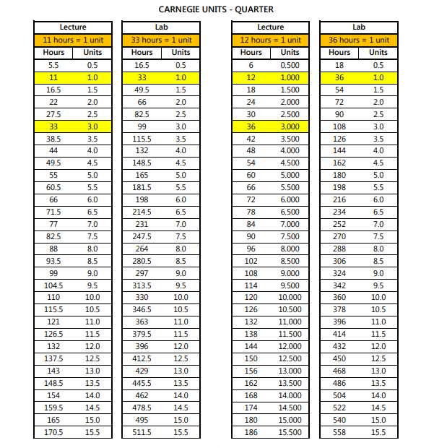
Appendix of Carnegie Credit Scale

Slide 10
SERVICE TEACHING ALLIANCE VOCATIONAL COLLEGE
Basic philosophy of our program
How we came up with our name
How was our experience

